Slide 1
Prof.mrs najma siddiqui
ANJUMAN COLLEGE OF ENGINEERING & TECHNOLOGY
Department of Electrical Engineering
SUB:- Basic Electrical Engineering

Slide 2
Unit I : Single Phase Transformers
Objectives: To understand-
Principle of operation of Single phase transformer,
Construction and types of Single phase transformer,
Concept of ideal transformer,
Operation at no load,
Operation on load,
Losses in transformer,
Open circuit test to determine core losses,
Short circuit test to determine copper losses,
Performance indices i.e. Efficiency and Voltage regulation,
Concept of maximum efficiency, condition for maximum efficiency,
Concept of Autotransformer, construction, kVA rating & saving of copper,
Applications

Slide 3
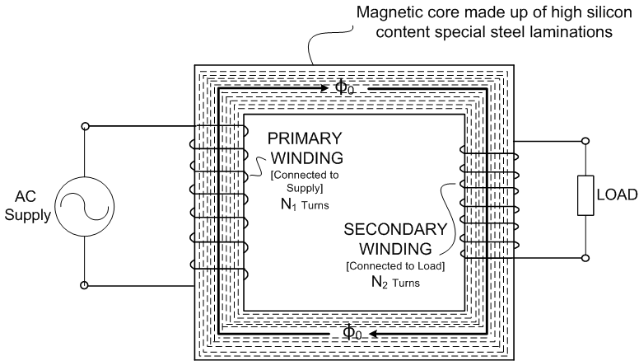
Definition of transformer:
Transformer is defined as
a static device
works on mutual induction
transforms electric power from one circuit to the other without any electric connection between them
at desired voltage level
without any change in frequency
Fig. 1.1 : Explanation of Transformer Definition

Slide 4
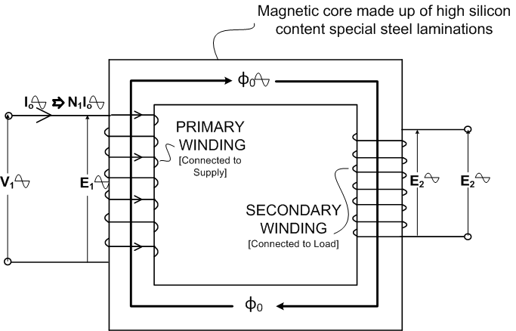
Principle of operation:
Transformer works on the basic principle of Electro-magnetic induction by Faraday which states that ‘ ‘ ‘Whenever a coil links with a changing magnetic flux, an EMF is induced in the coil’ and
‘This induced EMF is numerically equal to the rate of change flux linkages of the coil’
‘The induced EMF opposes the very cause of its own production, as per Lenz’s law.
Hence, the induced EMF is given by: e = - d/dt (Nφ)
Two coils being provided
on the common magnetic circuit are inductively coupled and when current in any one of these coils is changed uniformly, an emf is induced in the other coil.
Fig. 1.2 Principle of Operation

Slide 5
Transformation Ratio:
On neglecting losses in the transformer, its input shall be equal to output
i.e. V₁I₁ = V₂I₂
Dividing both sides by V₁I₂,
V₂/V₁ = E₂/E₁ = N₂/N₁ = I₁/I₂ = K
where K is known as Transformation ratio.
Ratio of turns on primary side to that of secondary side, N₁/N₂ = a . . . (Turns Ratio)
Transformation and Turns ratio are thus
_{k = 1/a}

Slide 6
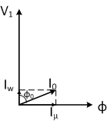
Theory of transformer operation:
AC supply when connected to primary winding of Transformer on no load, a current I_{o} ∟-φ₀ is drawn by the transformer for magnetizing the core and supplying core losses.
Magnetizing current,
I_{µ} = I₀ Sinφ₀
Core loss component,
I_{w} = I₀ Cosφ₀
So that, I₀ = I_{w} - jI_{µ}
Current I₀ flowing through N₁ turns of primary sets up an mmf N₁I₁ , which in turn sets up flux in core.
This flux links with both windings inducing EMFs E₁(opposing V₁) in primary and E₂ in secondary wdgs.

Slide 7
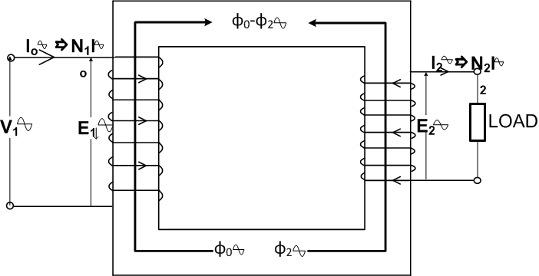
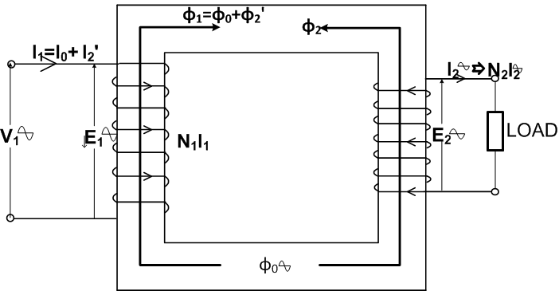
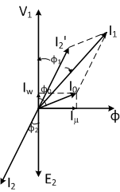
Theory of transformer operation (Contd…):
When load is connected across the secondary winding, the induced emf E₂ drives current I₂ through the load.
Current I₂ flowing through N₂ turns of secondary winding sets up flux φ₂ in the core, in opposition to flux φ₀.
Net flux being reduced, E₁ reduces in magnitude. As a result V₁ gets an upper hand over E₁ and a larger current I₁ = I₀ + I₂’ is drawn, where I₂’= -kI₂ is drawn for negating mmf setup by secondary current I₂.
Flux φ₂’ being equal but opposite to φ_{2,} net flux (hence flux density) in the core remains almost constant, from no load to full load.
W_{Eddy}(αB²) & W_{hysteresis} (αB^{1.6}) are constant.

Slide 8
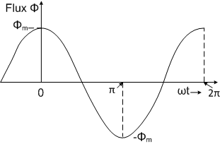
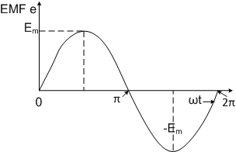
Emf equation of a transformer:
Flux setup in the core varies
sinusoidally & given by
ø = Φm cosωt ..As ø₀ = Φm & ø_{π/2} = 0
EMF induced in a winding , as per
law’s of EMI is e = - d(Nø)/dt
or e = - d(NΦ_{m} cosωt)
or e = NωΦ_{m}sinωt
The equation is in form, e = E_{m}sin ωt
i.e. E_{m} = NωΦ_{m} = 2πNfΦ_{m} (Em: Peak Value)
RMS value of EMF induced in winding,
E_{ph} = E_{m}/√2 = (^{2π}/_{√2})NfΦ_{m}
Or E_{ph}= 4.44 NfΦ_{m} …EMF Equation
Prim. wdg. emf, E₁ = 4.44N₁fΦ_{m} volts, & Second. wdg. emf, E₂ = 4.44N₂fΦ_{m}volts
Core Flux Waveform
EMF Waveform

Slide 9
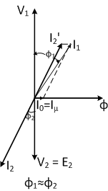
Concept of ideal transformer:
Ideal transformer is a hypothetical concept.
It is assumed to have following properties:
It has efficiency of 100%, as
It has no copper loss ( Both winding resistances negligible),
It has no core losses (Loss component, I_{w} = 0)
Core has infinite permeability,µ (Negligible magnetizing current, I_{µ})
It has Zero voltage regulation, as
Entire flux is setup in the core, ( No leakage flux & hence no leakage reactances )
Both windings are resistance free
It operates at load power factor

Slide 10
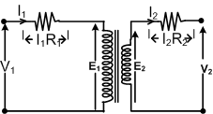
Practical transformer:
Ideal transformer is a hypothetical concept of a perfect transformer, but a practical transformer has following imperfections:
Winding Resistance: Windings of
a transformer, being made of
Cu wire, have some resistance.
Resistance of a winding is
considered by connecting
resistance in series with the
ideal winding.
R1 & R2 represent primary &
secondary winding resistances resp.
Voltage drops in the resp. windings
are I₁R₁ & I₂R₂.

Slide 11
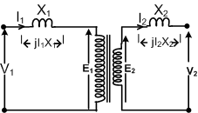
Practical transformer (Contd…) :
Leakage Flux: There being no good insulator of magnetic field, entire flux produced by a winding is not set up along intended path. Part of the flux links with the winding itself and is k/as Leakage flux.
Effect of leakage flux is to induce emf in the winding, in opposition to the cause producing it. As the leakage flux is not contributing towards transfer of electric power, this induced emf is considered as voltage drop in an imaginary reactance.
X₁ & X₂ represent primary &
secondary winding leakage
reactances resp.
Voltage drops in the resp.
windings are jI₁X₁ & jI₂X₂.

Slide 12
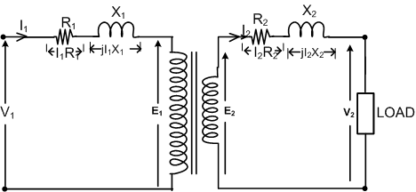
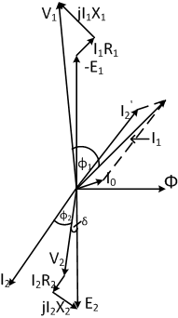
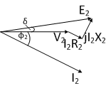
Practical transformer (Contd…) :
Each winding of the transformer has a resistance and a
leakage reactance.
Voltage equations for the
two sides are:
E₁ = V₁ – I₁R₁ – jI₁X₁, and
V₂ = E₂ – I₂R₂ – jI₂X2
Vector diagram for 2’ary
side is drawn for load
power factor with terminal
voltage as ref. vector. This
V.D. is rotated by –(90°+δ)
to project E2 vertically down.
Quantities on primary side
are drawn on the same
diagram, as shown to get
vector diagram of the
transformer at desired p.f.
V.D. for load side
V.D. of transformer on load at lag p.f.

Slide 13
LOSSES IN TRANSFORMER:
Two types of losses occur in a transformer:
1. Core loss or iron loss occur in iron core due to alternating
flux set up in it, and
2. Copper loss occurs in the windings due to current flowing
in them on loading the transformer.
Core Loss: These are of two types,
a. Eddy current loss, and b. Hysteresis loss
Eddy Current Loss: Emf induced in the core sets up eddy
current in the core, in turn eddy current loss occurs and is
given by W_{E}= K_{e} B_{m}²f²t² Watts, where Ke is eddy current
constant, t is thickness of the core.
Hysteresis Loss: Mag. Core exhibits property of lagging of the
flux density behind the magnetizing force when subjected to an
alternating flux. This property k/as hysteresis causes energy
loss, This loss is given by W_{H} = K_{h}B_{m}^{1.6}fV Watts
Copper Loss: This is loss of power due to heat produced by
currents in the windings. It is given by
P_{cu} = I₁²R₁ + I₂²R₂ = I₁²R₀₁= I₂²R₀₂

Slide 14
THANK YOU

